Slide 1
ACQUIRED MITRAL STENOSIS IN THE ADULT
ASE 2 Minute Tutorials: MS

Slide 2
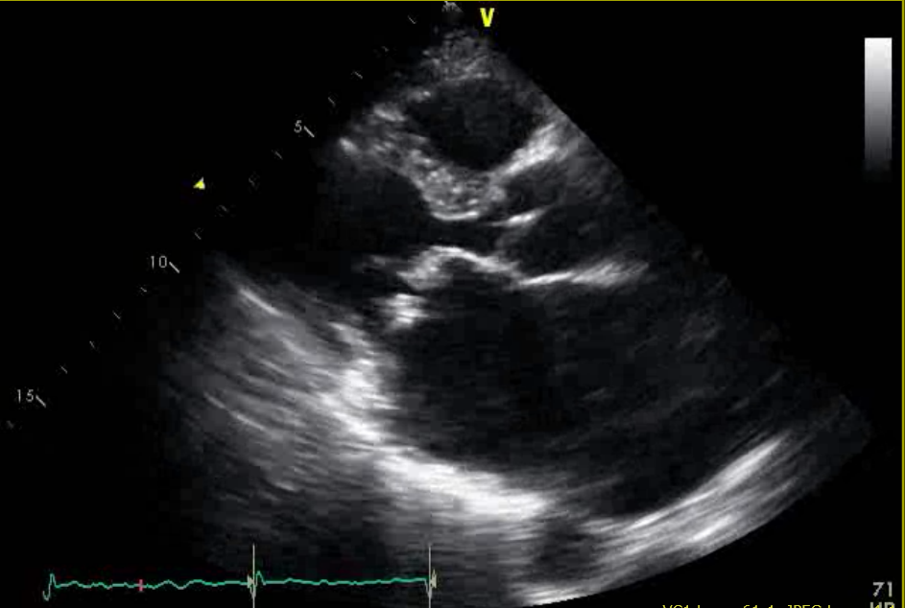
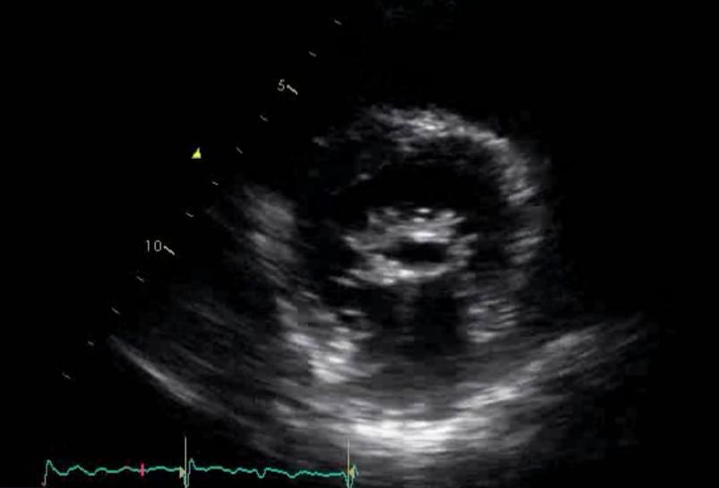
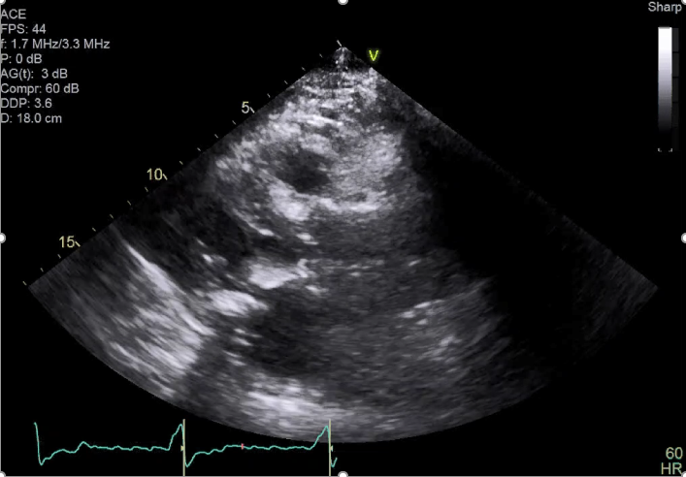
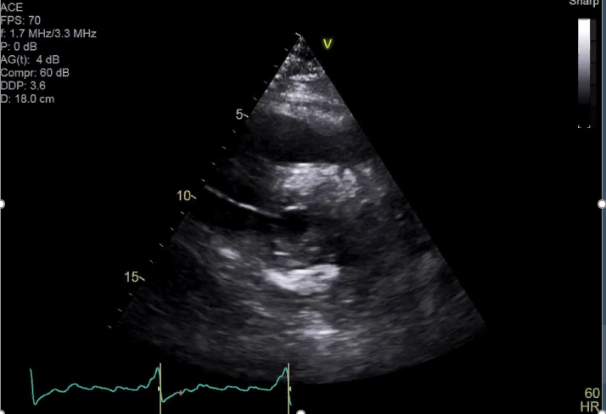
Rheumatic
ASE 2 Minute Tutorials: MS
Two main etiologies
Calcific
Leaflet thickening most pronounced at the tips, giving the characteristic “hockey-stick” appearance.
Commissural fusion.
Severe calcification of the mitral annulus, extending into the leaflets. Typically seen in the elderly (“senile”).
Rheumatic mitral stenosis, although uncommon, is more frequently the cause of mitral stenosis that is severe enough to require intervention.
Mitral annular calcification is much more common, though it is less often severe enough to cause significant stenosis.

Slide 3
Anatomic
ASE 2 Minute Tutorials: MS
Severity assessment
Hemodynamic
- Mitral valve area (MVA) by:
*Planimetry (2D and 3D)
*Continuity
*PISA
- Transmitral gradient (heart rate and flow dependent)
Pressure half time (PHT)
Pulmonary artery systolic pressure (PASP)
Classification
- Severe, if MVA is ≤1.5 cm² ; PHT ≥ 150 ms
- Very severe, if MVA is ≤ 1.0 cm² ; PHT ≥ 220 ms

Slide 4
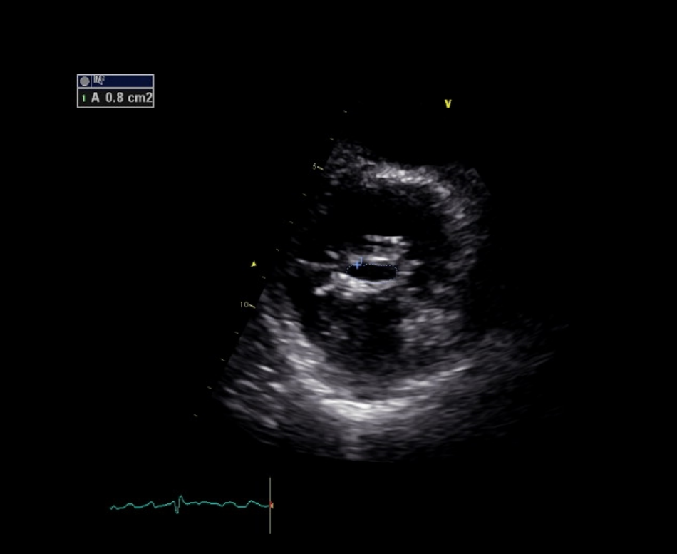
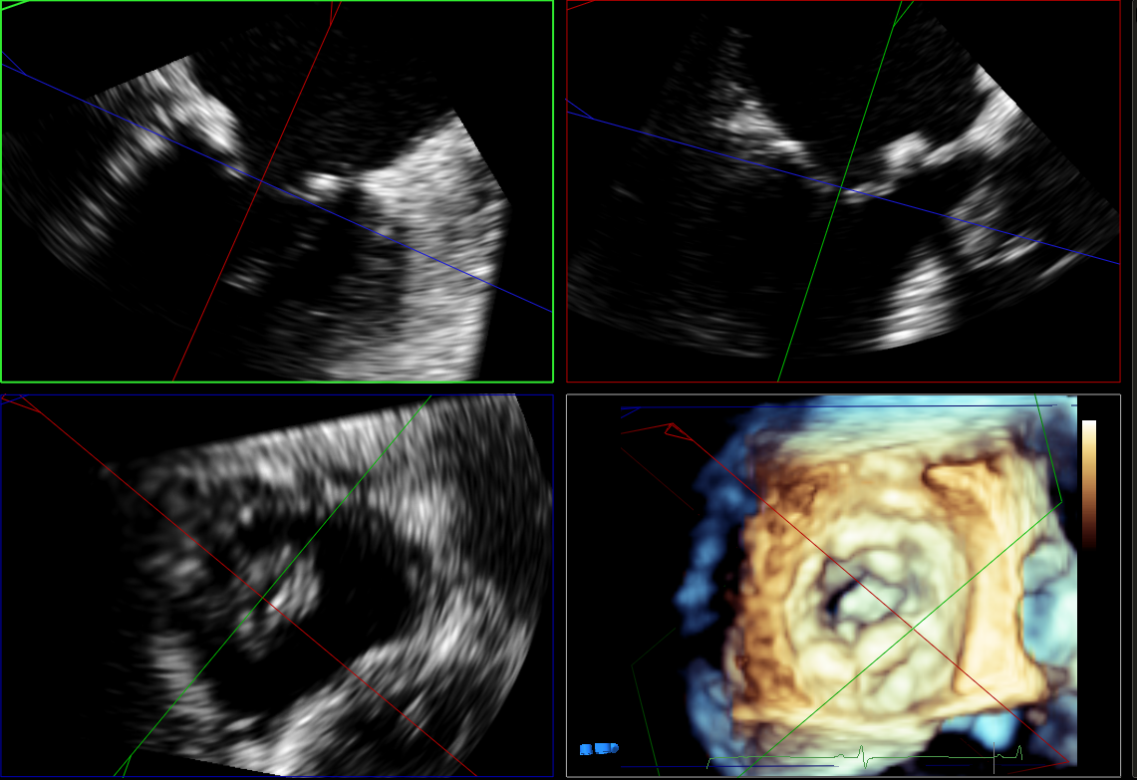
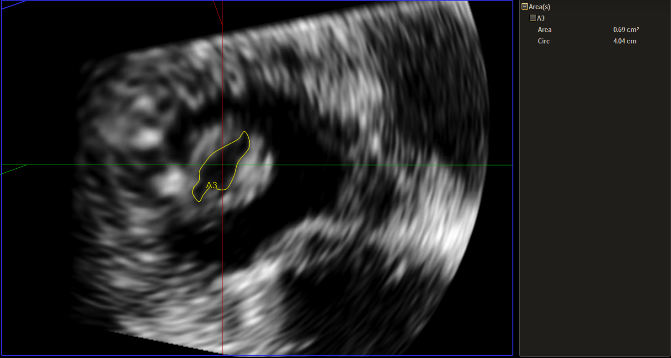
2D
ASE 2 Minute Tutorials: MS
MVA by planimetry (2D and 3D)
3D
3D planimetry, whenever feasible, is more accurate than to 2D planimetry, and is therefore the preferred methodology.
Notes:
Quantification of MS almost always can be performed with TTE. However TEE mitral valve area by 3D planimetry typically provides superior image quality.

Slide 5
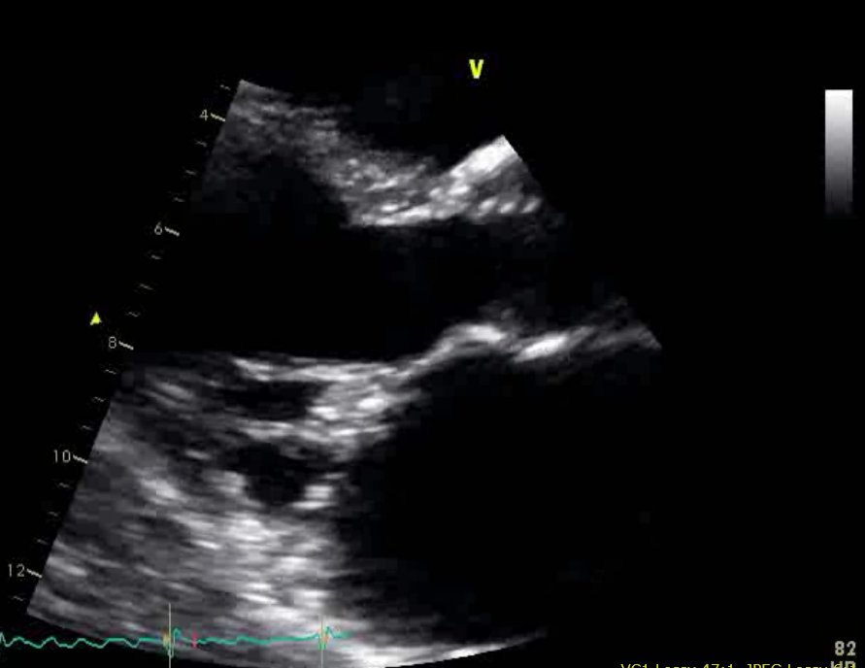
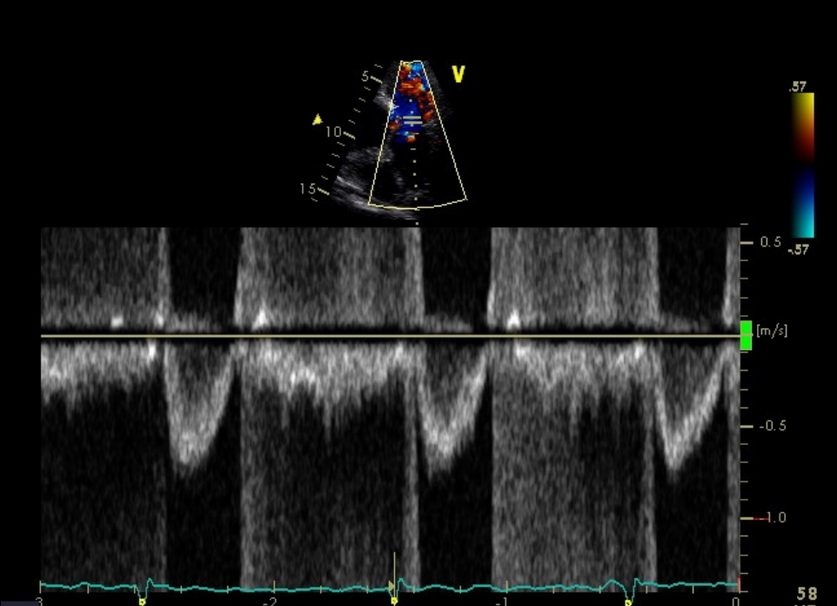
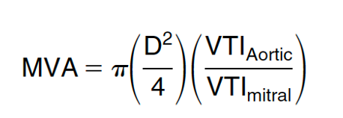
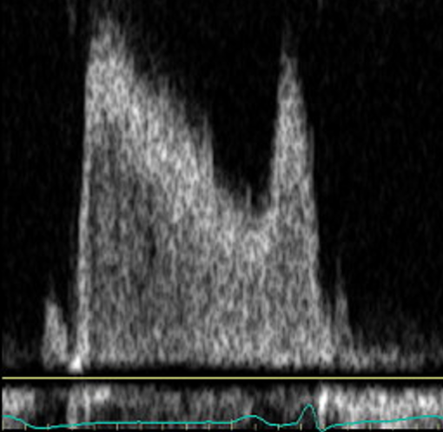
Principle
ASE 2 Minute Tutorials: MS
MVA by continuity
The stroke volumes proximal and distal to the stenotic mitral valve must be equal.
Mitral inflow = Aortic outflow
D
VTI_{Aortic}
D= LVOT diameter
VTI = Velocity time integral
VTI_{Mitral}

Slide 6
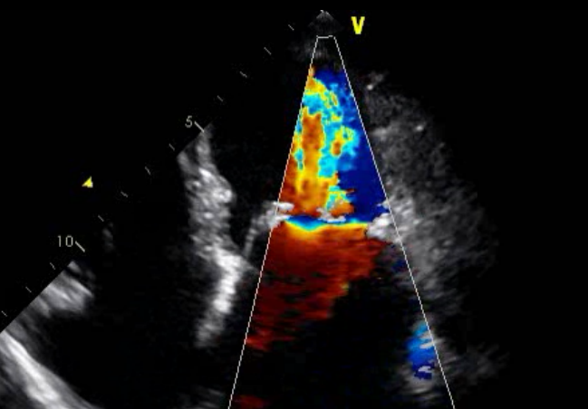
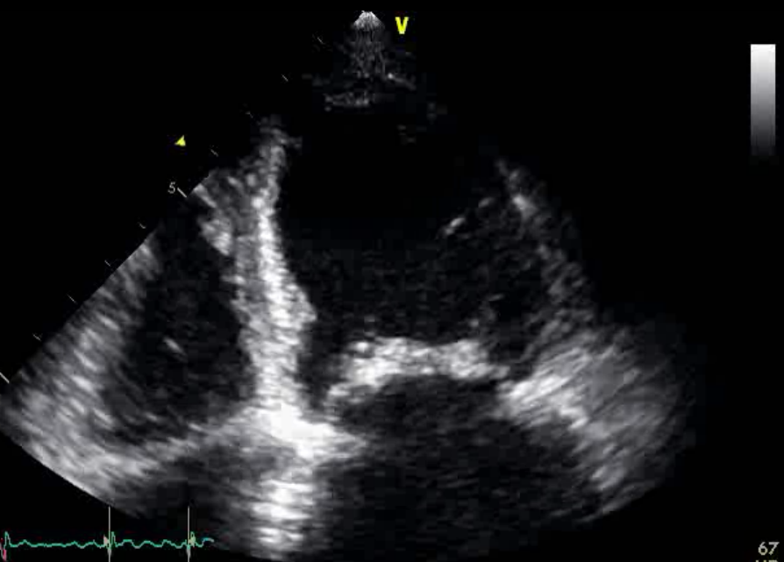
Principle
ASE 2 Minute Tutorials: MS
MVA by PISA
As flow accelerates towards the narrowed MV orifice, it forms hemispheric shells of increasing velocity and decreasing radius.
Because of mitral leaflet doming and the funnel shaped inflow, an angle correction factor of â°/180° needs to be accounted for, with â being the angle between the 2 leaflets at the atrial side.
MVA = 6.28 r² x Alias_{vel}/Peak_{MSvelocity} x â°/180°
â°
r = PISA radius
Alias_{vel} = Aliasing velocity
Peak_{MSvelocity} = Peak MS velocity
â° = angle between the 2 leaflets

Slide 7
Principle
ASE 2 Minute Tutorials: MS
Transmitral gradient
The mean pressure gradient varies with heart rate and forward ﬂow.
However, usually*:
<5 mm Hg – mild MS
5–10 mm Hg – moderate MS
>10 mm Hg – severe MS
*at heart rates between 60-80 bpm and in sinus rhythm.

Slide 8
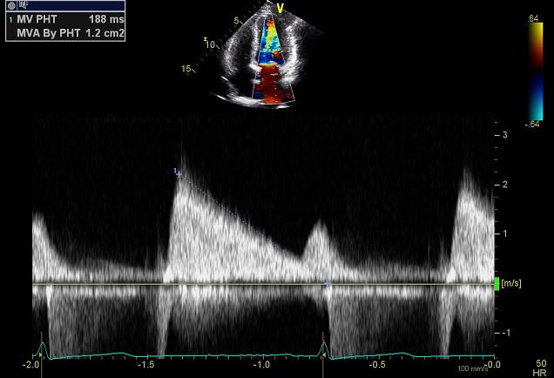
Principle
ASE 2 Minute Tutorials: MS
Pressure Half Time (PHT)
The PHT reflects the time taken for the trans-mitral pressure gradient to decay to half its value at the onset of diastole.
There is a linear and inverse relationship between MVA and PHT: the more severe the MS, the longer the PHT
Empirical formula to derive MVA from PHT:
MVA = 220/PHT

Slide 9
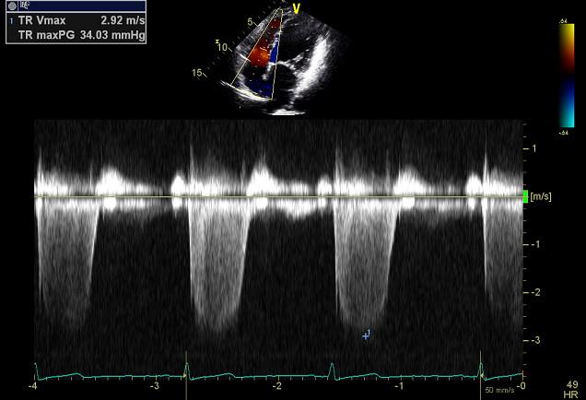
Principle
ASE 2 Minute Tutorials: MS
Estimated pulmonary pressure
The obstruction of flow at the mitral orifice results in pulmonary hypertension.
The degree of pulmonary hypertension is a measure of the hemodynamic burden of MS.
Elevated pulmonary artery systolic pressure (PASP) >30 mm Hg is typically seen in severe MS.
PASP can be estimated by measuring the tricuspid regurgitant jet maximum velocity by continuous wave (CW) spectral Doppler.
PASP = 4 (TR V_{Max})² + RA pressure

Slide 10
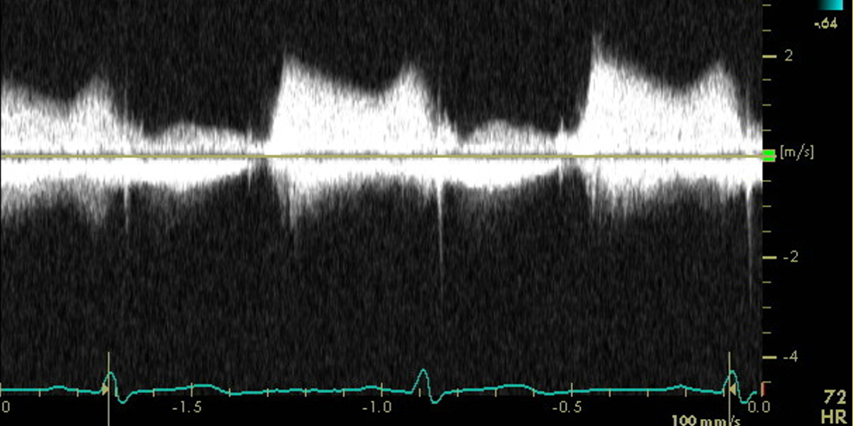
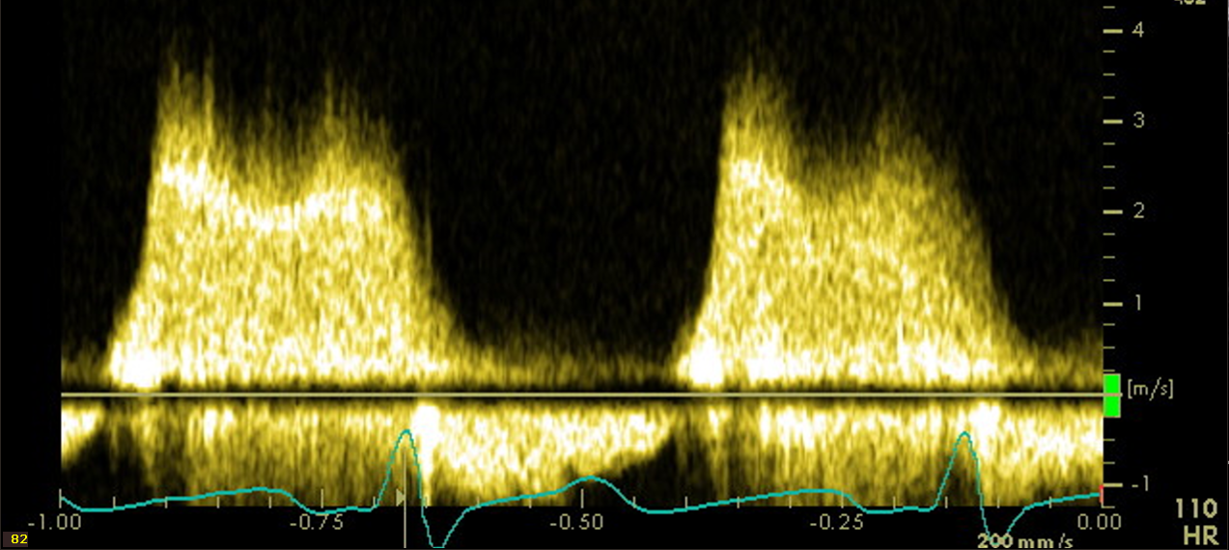
Principle
ASE 2 Minute Tutorials: MS
Exercise stress testing
Mitral stenosis is considered hemodynamically significant, if during exercise:
Pulmonary artery wedge pressure is greater than 25 mm Hg or,
Mean mitral valve gradient is greater than 15 mm Hg.
Exercise
Mean gradient of 9 mmHg at rest (HR of 72 bpm)
Mean gradient of 19 mmHg with exercise
(HR of 110 bpm)

Slide 11
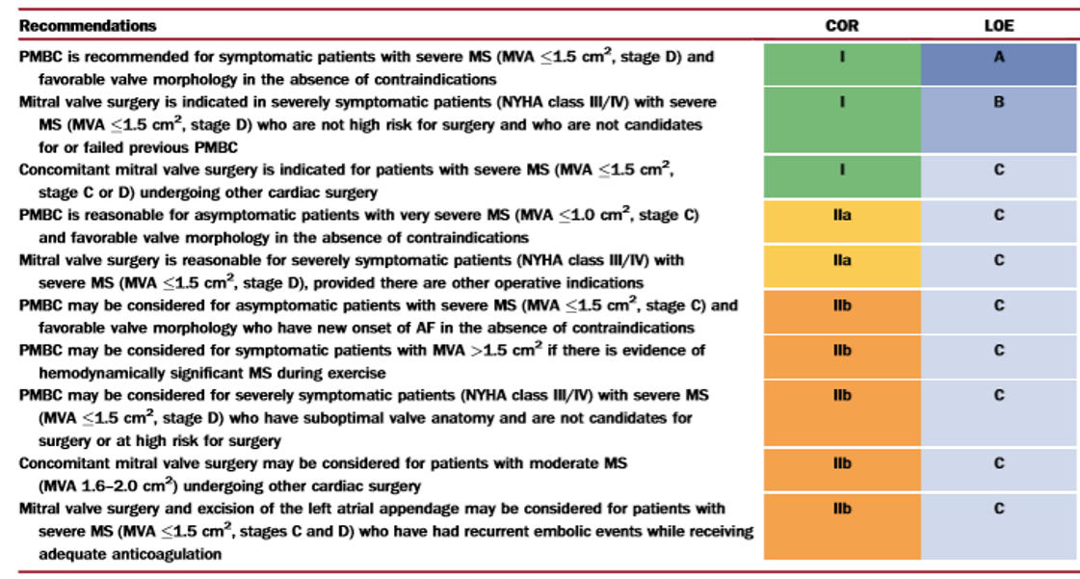
Types
ASE 2 Minute Tutorials: MS
Intervention
Indications
- Mitral Valve Surgery.
- PMBC: Percutaneous mitral balloon commissurotomy (typically performed under TEE guidance).
Nishimura et.al. J Am Coll Cardiol. 2014;63:e57-185

Slide 12
ASE 2 Minute Tutorials: MS
References
Nishimura RA, Otto CM, Bonow RO, Carabello BA, Erwin JP, 3rd, Guyton RA, O'Gara PT, Ruiz CE, Skubas NJ, Sorajja P, Sundt TM, 3rd, Thomas JD. 2014 aha/acc guideline for the management of patients with valvular heart disease: A report of the american college of cardiology/american heart association task force on practice guidelines. J Am Coll Cardiol. 2014;63:e57-185
https://www.sciencedirect.com/science/article/pii/S0735109714012790?via%3Dihub
Baumgartner H, Hung J, Bermejo J, Chambers JB, Evangelista A, Griffin BP, Iung B, Otto CM, Pellikka PA, Quinones M. Echocardiographic assessment of valve stenosis: Eae/ase recommendations for clinical practice. J Am Soc Echocardiogr. 2009;22:1-23
https://www.asecho.org/wp-content/uploads/2014/05/2009_Echo-Assessment-of-Valve-Stenosis.pdf

