Slide 1
Quantification of Mitral Regurgitation
Proximal Isovelocity Surface Area (PISA) Method

Slide 2
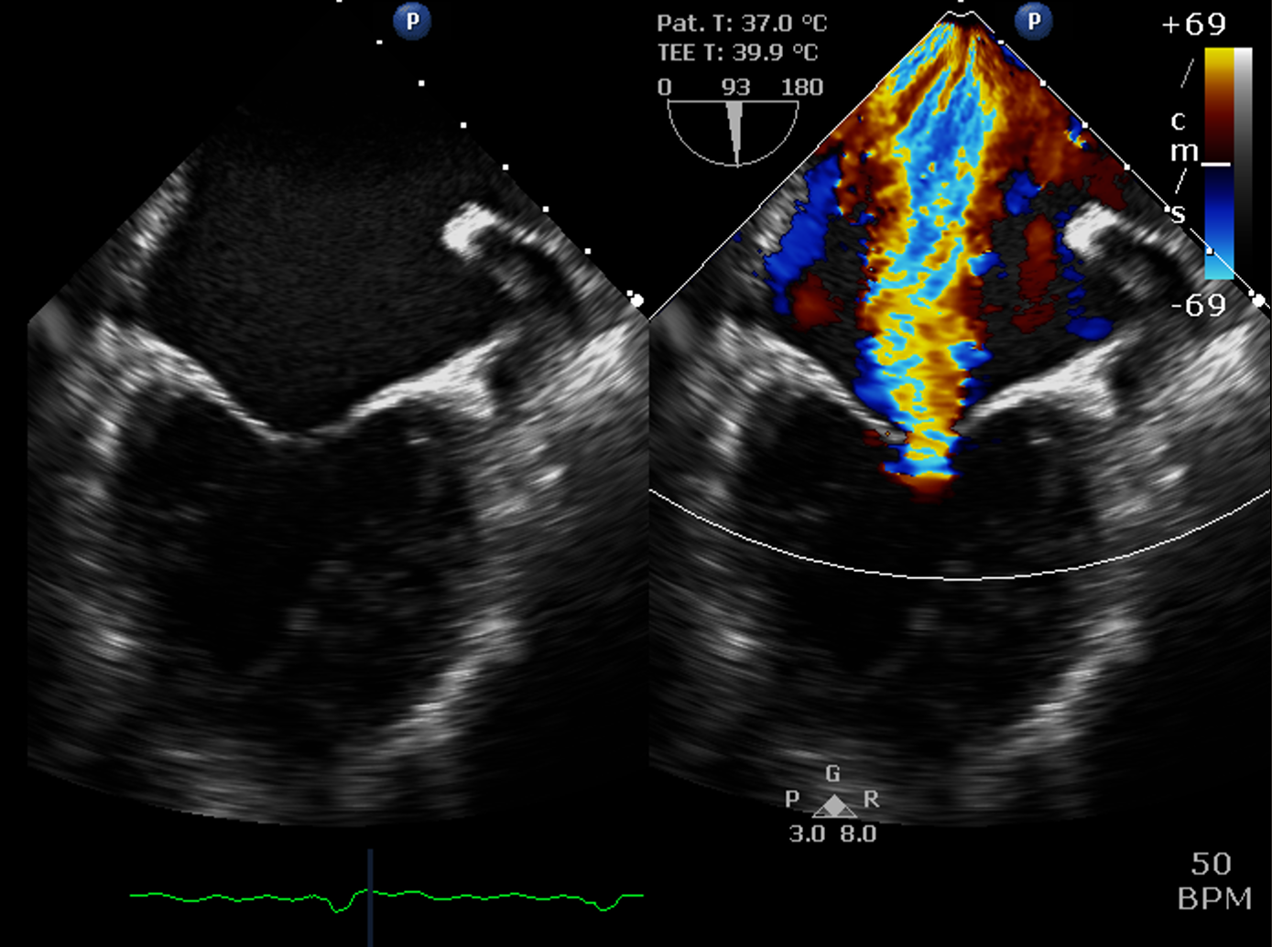
ASE 2 Minute Tutorials: PISA
Quantification of Mitral Regurgitation
Proximal Isovelocity Surface Area (PISA) Method
The mitral valve is complex with significant variation in its morphology and supporting structure.
Due to this complexity, ASE recommends grading degree of mitral regurgitation with an integrative approach utilizing multiple quantitative and qualitative metrics.
Integrative Approach to Mitral Regurgitation:
Proximal Isovelocity Surface Area (PISA) Method
Doppler comparison of volumes
2D vena contracta width and 3D vena contracta area
Leaflet pathology (flail leaflet)
Completeness of Doppler profile
Pulmonary vein flow reversal
Mitral valve inflow velocities
Left atrial size
Pulmonary pressure
Left ventricular systolic function and dilation

Slide 3
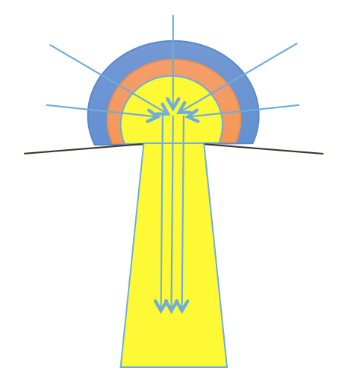
ASE 2 Minute Tutorials: PISA
Quantification of Mitral Regurgitation
Proximal Isovelocity Surface Area (PISA) Method
PISA Calculation Relies on Continuity Equation:
Flow Rate 1 = Flow Rate 2
Flow Rate = Velocity x Area
Thus:
Velocity 1 x Area 1 = Velocity 2 x Area 2
Variables:
Velocity 1 = Nyquist limit
Area 1 = Surface area of flow convergence hemisphere
Velocity 2 = Peak MR velocity by continuous wave Doppler through mitral valve
Area 2 = Effective Regurgitant Orifice Area (EROA)
Goal:
Solve for EROA

Slide 4
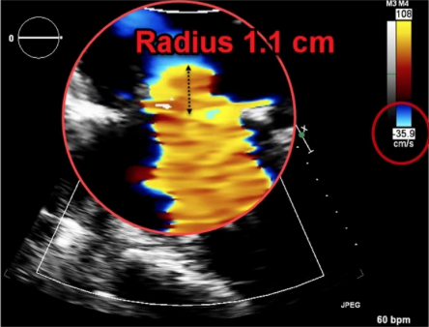
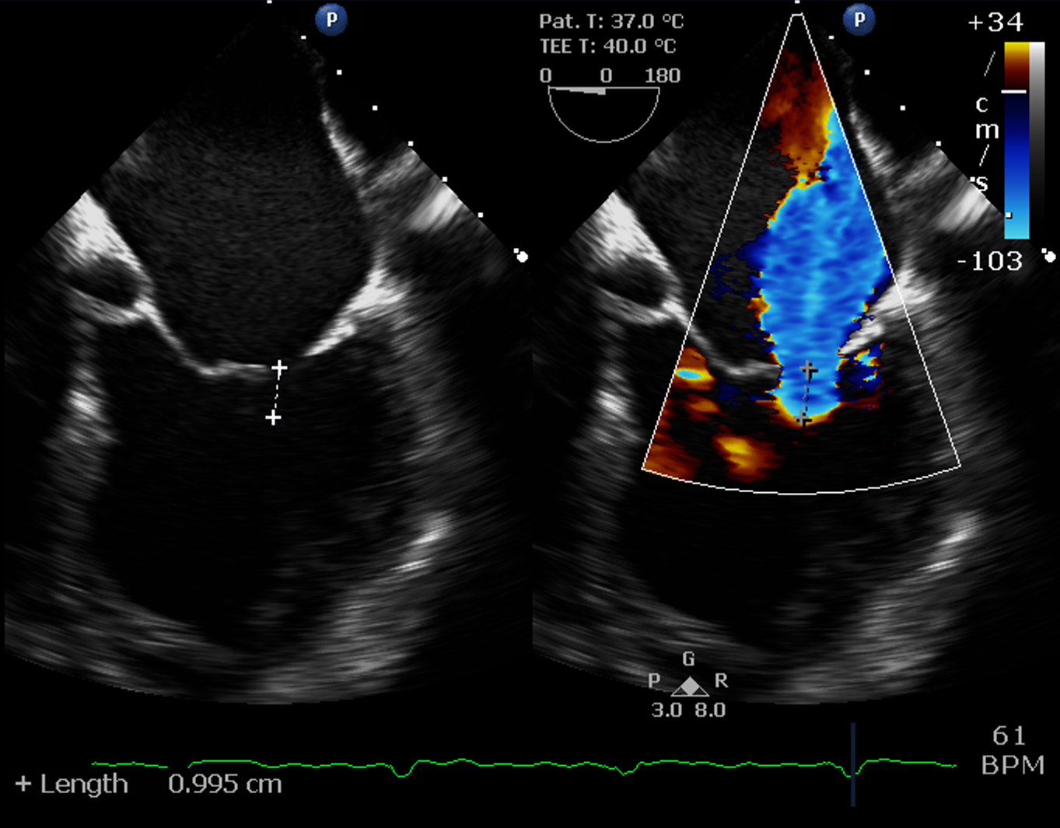
ASE 2 Minute Tutorials: PISA
Quantification of Mitral Regurgitation
Proximal Isovelocity Surface Area (PISA) Method
30 cm/s
TTE
TEE
28 cm/s
34 cm/s
Placeholder
Image
*TIP*: PISA envelope is dynamic and frame rate should be maximized with a narrow color sector and minimum required depth or using a dedicated zoom mode
Step 1: Baseline shift Nyquist limit TOWARDS direction of flow. The edge of the color flow is formed by concentric hemispheric shells of equal velocity.
Velocity 1 = Nyquist Limit

Slide 5
ASE 2 Minute Tutorials: PISA
Quantification of Mitral Regurgitation
Proximal Isovelocity Surface Area (PISA) Method
Step 2: Measure the radius of the hemisphere from the anatomic regurgitant orifice to the edge of the PISA hemispheric shell
Step 3: Calculate the surface area of hemisphere using formula 2πr²
Area 1 = 2πr²
**Caution**
Radius measurement is prone to errors from an inadequately acquired envelope, inadequate frame rate, measurement error.
These errors are squared!
*TIP*
Measure completely to anatomic regurgitant orifice of mitral valve; color compare mode may help.
Don’t be fooled by a circular appearance. Edges of hemisphere are present but not visualized as flow in this region is perpendicular to the Doppler beam angle of incidence (red arrows)

Slide 6
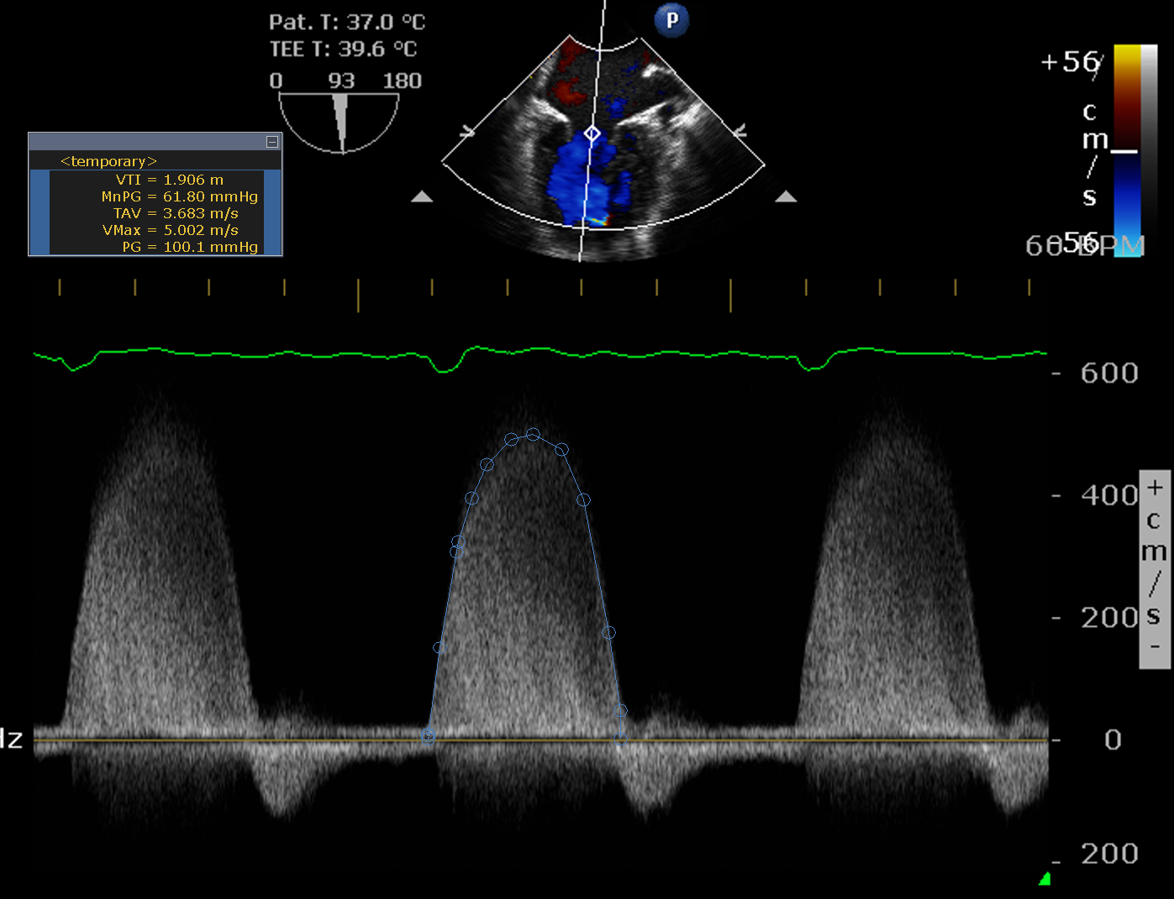
ASE 2 Minute Tutorials: PISA
Quantification of Mitral Regurgitation
Proximal Isovelocity Surface Area (PISA) Method
Step 4:
Velocity 2 obtained from the peak continuous wave spectral Doppler of mitral regurgitant jet (yellow arrow)
*TIP*: Go ahead and trace the entire mitral envelope to obtain the velocity time integral (VTI). This will be used in Step 5 to obtain mitral regurgitant volumes.

Slide 7
ASE 2 Minute Tutorials: PISA
Quantification of Mitral Regurgitation
Proximal Isovelocity Surface Area (PISA) Method
Step 5: Solve for Area 2:
(Velocity 1 x Area 1)/Velocity 2 = Area 2
Velocity 1 = Nyquist limit
Area 1 = Surface area of hemisphere
Velocity 2 = Peak velocity by continuous wave Doppler through mitral valve
Area 2 = Regurgitant oriface area (ERO)
Degree of Mitral Regurgitation:
Mild: EROA < 0.2 cm²
Moderate: EROA = 0.2- 0.4 cm²
Severe: EROA > 0.4 cm²

Slide 8
ASE 2 Minute Tutorials: PISA
Quantification of Mitral Regurgitation
Proximal Isovelocity Surface Area (PISA) Method
Example:
PISA Radius 0.8 cm at ERO of 38 cm/s
Peak MR Velocity 5.50 m/sec
Velocity 1 x Area 1 = Velocity 2 x Area 2
Velocity 1 = Nyquist Limit: 38 cm/s
Area 1 = Surface area of hemisphere (2πr²): (2*π*0.8²) = 4.02 cm²
Velocity 2 = Peak MR Velocity = 550 cm/s
Area 2 = EROA
EROA = (Nyquist Limit: 38 cm/s) * (Surface area of hemisphere 4.02 cm²) / (Peak MR Velocity = 550 cm/s)
EROA = 0.28 cm² = Moderate Mitral Regurgitation

Slide 9
ASE 2 Minute Tutorials: PISA
Quantification of Mitral Regurgitation
Proximal Isovelocity Surface Area (PISA) Method
Step 6: Calculate Mitral Regurgitant Volume
Regurgitant Volume = EROA * VTI
Example:
EROA = 0.28 cm²
VTI = 150 cm
Regurgitant Volume = 0.28 cm² * 150 cm
Regurgitant Volume = 42 mL (cm³) = Moderate Mitral Regurgitation
Degree of Mitral Regurgitation:
Mild: RF < 30 mL
Moderate (Grade II) = 30-44 mL
Moderate (Grade III) = 45-59 mL
Severe: RV > 60 mL

Slide 10
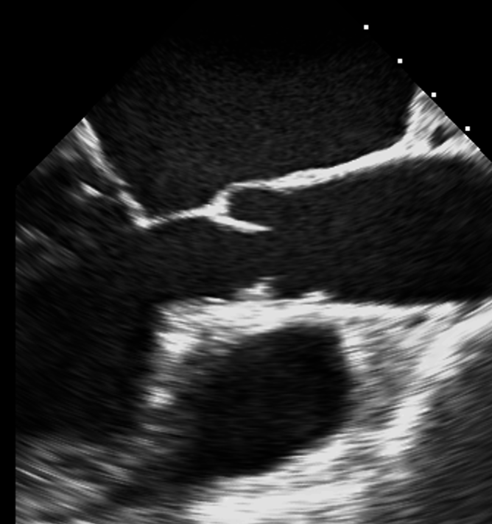
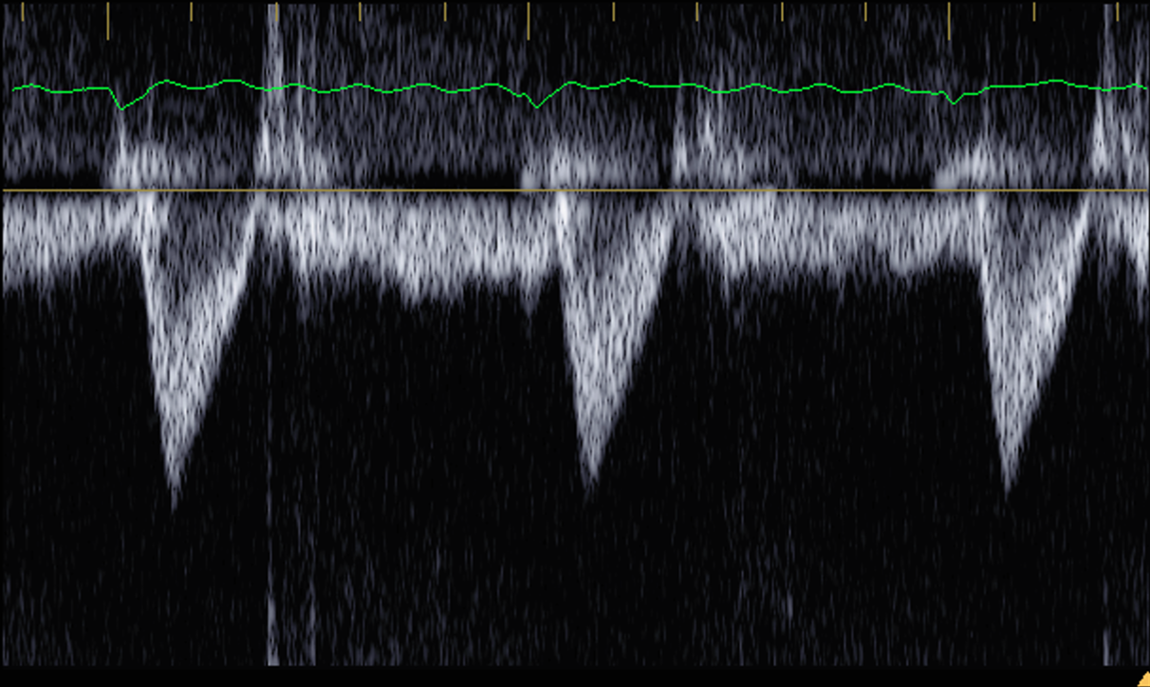
ASE 2 Minute Tutorials: PISA
Quantification of Mitral Regurgitation
Proximal Isovelocity Surface Area (PISA) Method
Step 7: Calculate Mitral Regurgitant Fraction
Left Ventricular Outflow Tract (LVOT) Stroke Volume (SV)
LVOT SV = LVOT Cross Sectional Area (CSA) * LVOT VTI
LVOT CSA derived from diameter of left ventricular outflow tract (yellow line)
LVOT VTI derived from pulse wave Doppler in LVOT
Total Left Ventricular Stroke Volume = Mitral Regurgitant Volume + Aortic Stroke Volume
Mitral Regurgitant Fraction = Mitral Regurgitant Volume / Total Left Ventricular Stroke Volume

Slide 11
ASE 2 Minute Tutorials: PISA
Quantification of Mitral Regurgitation
Proximal Isovelocity Surface Area (PISA) Method
Example:
LVOT Diameter = 2 cm
LVOT Radius = 1 cm
LVOT Cross Sectional Area = π*r² = 3.14 cm²
LVOT VTI = 20 cm
LVOT Stroke Volume = 20 cm * 3.14 cm² ≃ 63 mL (cm³)
Mitral Regurgitant Volume = 42 mL (cm³)
Total LV Stroke Volume = 63 mL + 42 mL = 105 mL
Mitral Regurgitant Fraction = 42 mL / 105 mL = 40%
Degree of Mitral Regurgitation:
Mild: RF < 30%
Moderate (Grade II) = 30-39%
Moderate (Grade III) = 40-49%
Severe: RV > 50%

Slide 12
ASE 2 Minute Tutorials: PISA
Quantification of Mitral Regurgitation
Proximal Isovelocity Surface Area (PISA) Method
PISA PITFALLS
PISA calculation assumes circular mitral valve orifice. This is frequently not the case, particular in cases of secondary (functional) mitral regurgitation.
PISA calculation assumes static shape to mitral orifice, however mitral valve shape is frequently complex and dynamic such as in mitral valve prolapse, making calculation of regurgitant volume and fraction critical.
PISA calculation assumes single jet of mitral regurgitation, but multiple jets frequently present
PISA shape rapidly changes in size and low frame rate may underestimate degree of mitral regurgitation or peak systolic PISA radius may overestimate degree of mitral regurgitation.
Contamination from dynamic flow through left ventricular outflow tract may prevent acquisition of PISA envelope
Accurate acquisition of PISA requires sonographer and echocardiographer skill and persistence
PISA difficult to obtain after surgical or transcatheter replacement or repair of mitral valve
Non-circular MR Jet

Slide 13
Summary: PISA Quick Method
PISA EROA = 2 x π x r² x Nyquist
Peak MR velocity
PISA EROA = 6.28 x r² x Nyquist
Peak MR velocity
IF:
-Nyquist baseline shift at least 40 cm/s
-Peak MR assumed to be 500 cm/s
¹Simplified PISA ≃ r2
2

Slide 14
ASE 2 Minute Tutorials: PISA
Quantification of Mitral Regurgitation
Proximal Isovelocity Surface Area (PISA) Method
Additional Reading:
Zoghbi et al. Recommendations for Noninvasive Evaluation of Native Valvular Regurgitation A Report from the American Society of Echocardiography Developed in Collaboration with the Society for Cardiovascular Magnetic Resonance.

