Slide 1
Executive Branch & Federal Rulemaking 101
ASE's Guide to Navigating the Regulatory Process

Slide 2
Why the Executive Branch Matters for Health Care
Congress passes the law, but the executive branch decides how it works in practice
Reimbursement
Rates
Coverage
Decisions
Device
Regulation
Research
Funding
CMS sets what Medicare pays for every cardiovascular procedure and imaging service, not Congress.
Whether a procedure is covered by Medicare is decided through CMS rulemakings and coverage determinations.
FDA approval pathways determine how quickly new echo equipment and AI imaging tools reach clinical practice.
NIH and NHLBI set cardiovascular research priorities and award grants which are shaped by agency leadership and budget.

Slide 3
Understanding the Executive Branch Structure
Section One

Slide 4





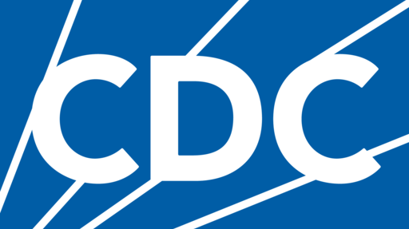

The Executive Branch: An Overview
The President leads the executive branch and sets the policy direction for all federal agencies.
The President
Dept. of Health & Human Services (HHS)
CMS
FDA
NIH
CDC
HRSA
SAMHSA
Key Distinction
Congress passes laws that authorize and fund agency activities.
Agencies then implement those laws through regulations, guidance, and administrative action. That implementation directly shapes how health care is delivered and paid for.

Slide 5

The Department of Health & Human Services (HHS)
The parent department overseeing nearly all federal health policy and the most important for ASE
Led by the HHS Secretary, a presidential cabinet appointee confirmed by the Senate, sets department policy direction and budget priorities
15 Operating Divisions: CMS, FDA, NIH, CDC, HRSA, SAMHSA, AHRQ, and others;
  Each with distinct missions and rulemaking authority
Staff Divisions: Office of the Assistant Secretary for Health (OASH), Office of General Counsel, and Office of the Inspector General
Annual Budget: ~$1.7 Trillion - the largest federal department by expenditure, driven primarily by Medicare and Medicaid mandatory spending
Primary Relationships
CMS
(payment & coverage)
NIH/NHLBI
(research funding)
FDA
(devices & AI tools)

Slide 6
HHS Operating Divisions: Who Does What
Each division has distinct regulatory authority and a different role in health care policy.
CMS
FDA
Centers for Medicare & Medicaid Services
Food & Drug Administration
Sets Medicare/Medicaid payment rates, coverage policies, and quality programs.
Regulates medical devices, drugs, biologics, and AI-assisted diagnostic tools.
NIH
CDC
National Institutes of Health
Centers for Disease Control & Prevention
Primary federal funder of biomedical research, including cardiovascular science.
Cardiovascular disease surveillance, public health data, and prevention programs.
Health Resources & Services Administration
Agency for Healthcare Research & Quality
HRSA
Health workforce, rural health, and community health center funding.
AHRQ
Comparative effectiveness research that informs coverage and clinical guidelines.
Substance Abuse & Mental Health Services Admin.
Administration for Strategic Preparedness & Response
SAMHSA
ASPR
Behavioral health programs; intersects with cardiovascular care in integrated settings.
Public health emergency preparedness; relevant during health system disruptions.

Slide 7
HHS Agencies That Matter Most for Echocardiography
Section Two

Slide 8
Centers for Medicare & Medicaid Services (CMS)
The most important agency for ASE members as CMS controls how cardiovascular care is paid for.
Medicare Reimbursement:
Sets payment rates for every physician service, including all echocardiography CPT codes, through the annual Physician Fee Schedule (PFS).
Medicare Advantage (Part C)
Regulates private Medicare Advantage plans, which cover ~50% of Medicare beneficiaries and increasingly affect echo utilization.
Medicaid Policy
Sets federal minimum standards for Medicaid and approves state Medicaid plans, affecting coverage in lower-income patient populations.
Coverage Determinations
Issues National Coverage Determinations (NCDs) and Local Coverage Determinations (LCDs) that decide whether Medicare will pay for a procedure at all.
Prior Authorization
CMS has expanded prior authorization requirements for imaging services which is a direct quality and access concern for echo providers.
Quality Programs
Administers MIPS/APMs under the Quality Payment Program which affects how cardiologists are measured and paid under value-based care.

Slide 9
Food & Drug Administration (FDA)
FDA regulates the tools ASE members use from echo machines and contrast agents to AI-assisted imaging software.
Medical Devices:
All echocardiography equipment, transducers, and accessories regulated by FDA's Center for Devices and Radiological Health (CDRH)
Contrast Agents:
Ultrasound contrast agents (UCAs) regulated as drugs. FDA has authority over approvals, labeling, and safety communications
Device Approval Pathways:
510(k) clearance (most common), PMA for high-risk devices, De Novo for novel low-to-moderate risk devices
Lab-Developed Tests (LDTs):
FDA's evolving oversight may affect molecular and imaging biomarker tests used in cardiovascular diagnosis
Software as a Medical Device (SaMD):
AI-assisted echo analysis tools and clinical decision support software regulated under FDA's evolving SaMD framework
ASE's FDA Role:
Submit comments on device guidance, participate in advisory committee meetings, engage CDRH staff on echo-specific issues

Slide 10
National Institutes of Health (NIH)
NIH is the primary federal funder of biomedical research including cardiovascular research.
Annual Budget:
~$48 billion per year in discretionary funding
Set annually through the congressional appropriations process
Budget cuts directly reduce available research grants
National Heart, Lung & Blood Institute (NHLBI):
Key NIH institute for cardiovascular research
Funds basic science, clinical trials, and epidemiologic studies directly relevant to echo and cardiac imaging
Grant Funding & Research Priorities:
NIH sets research priority areas that shape which cardiovascular questions get studied
Advocacy can influence these priorities through public comment and institute advisory councils
Clinical Trial Infrastructure:
NIH funds large cardiovascular trials (e.g., ARIC, CARDIA) that generate the evidence base for echo guidelines and clinical practice.
ASE's Engagement with NIH:
ASE can submit feedback on NIH strategic plans, nominate members to NHLBI advisory councils, and advocate for cardiovascular imaging research funding during the appropriations process.

Slide 11


Other Agencies with Impact on Echocardiography
Beyond CMS, FDA, and NIH, these agencies also shape the environment in which ASE members practice.
CDC – Center for Disease Control & Prevention
HRSA — Health Resources & Services Administration
AHRQ — Agency for Healthcare Research & Quality
ONC — Office of the National Coordinator for Health IT
Tracks cardiovascular disease burden and mortality to provide data that drives policy priorities
Funds prevention programs that affect cardiovascular screening and access
Heart disease surveillance shapes the political case for cardiovascular research funding
Workforce programs affect the supply of echocardiographers and sonographers
Rural health designations and funding affect where echo services are available
Community health centers serve underserved patients who rely on echocardiography access
Workforce programs affect the supply of echocardiographers and sonographers
Rural health designations and funding affect where echo services are available
Community health centers serve underserved patients who rely on echocardiography access
Produces comparative effectiveness research used in coverage and reimbursement decisions
Funds research on health IT, quality measures, and clinical practice guidelines
AHRQ evidence reviews can directly influence CMS coverage determinations (LCDs/NCDs)
Produces comparative effectiveness research used in coverage and reimbursement decisions
Funds research on health IT, quality measures, and clinical practice guidelines
AHRQ evidence reviews can directly influence CMS coverage determinations (LCDs/NCDs)
Sets interoperability and EHR standards that affect how echo reports and images are shared
Information blocking rules affect patient access to imaging data
Rulemaking on clinical decision support tools intersects with AI-assisted echo
Sets interoperability and EHR standards that affect how echo reports and images are shared
Information blocking rules affect patient access to imaging data
Rulemaking on clinical decision support tools intersects with AI-assisted echo

Slide 12
What Is Federal Rulemaking?
Section Three

Slide 13
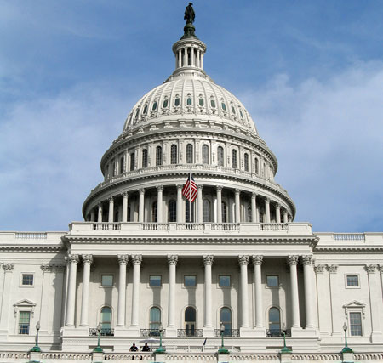



What Is a Federal Rule?
Rules are how agencies translate law into binding, enforceable policy.
Federal Rules Are Legally Binding:
Impact on physicians, patients, manufacturers, and payers — carrying the same weight as the laws that authorize them
Federal Rules are Authorized by Congress:
agencies can only write rules within the statue / scope of authority Congress has delegated; rules that exceed that authority can be challenged in court
Rules are Published in the Federal Register:
all proposed and final rules must be published, giving the public notice and opportunity to comment
Rules vs. Guidance:
sub-regulatory guidance (FAQs, program memos, transmittals) is NOT legally binding but is widely followed; guidance can be issued without a public comment period
"Congress opens the door. The agency decides what's inside the room."

Slide 14
Types of Agency Actions
Not all agency actions carry the same weight or require the same public process.
Proposed Rule:
Formal public proposal for a new or amended rule; published in the Federal Register with a public comment period (typically 60 days)
Final Rule:
Becomes legally binding typically 60 days after publication; agencies must address substantive comments in the preamble
Interim Final Rule:
Takes effect immediately but still accepts public comments; used in emergencies (e.g., extensively during COVID-19)
Sub-Regulatory Guidance:
FAQs, memos, transmittals — not legally binding but widely followed in practice; issued without a formal comment period
National Coverage Determination (NCD):
Formal CMS decision on whether Medicare covers a specific service; applies nationally; requires an evidence review process

Slide 15
Types of Agency Actions
Not all agency actions carry the same weight or require the same public process.
Proposed Rule:
An agency's formal public proposal for a new or amended rule. Published in the Federal Register with a public comment period (typically 60 days). The starting point for most significant rules.
Proposed, not yet law
Final Rule:
Published after the agency reviews public comments. Becomes legally binding, typically 60 days after publication. Agencies must address substantive comments in the preamble.
Legally binding
Interim Final Rule:
Used in emergencies or time-sensitive situations. Takes effect immediately but still accepts public comments that may result in later amendments. Used extensively during COVID-19.
Immediately binding
Sub-Regulatory Guidance:
Instructions and interpretations issued without a formal comment period. Not legally binding but widely followed in practice. CMS transmittals, FAQ documents, and program memos fall here.
Not legally binding
National Coverage Determination (NCD):
A formal CMS decision on whether Medicare will cover a specific service, item, or technology. Applies nationally to all Medicare beneficiaries. Requires an evidence review process.
Binding for Medicare

Slide 16
The Rulemaking Process: Step by Step
The Administrative Procedure Act governs how agencies must make rules. This creates predictable opportunities for public engagement.
Step 1 — Law Enacted
Congress passes legislation authorizing agency rulemaking
Step 2 — Agency Drafts Rule
Internal policy development; stakeholders can engage agency staff here
Step 3 — Proposed Rule Published
Proposed rule posted in the Federal Register; public comment period opens
Step 4 — Public Comment
Typically 60 days; anyone can submit written comments at Regulations.gov
Step 5 — Agency Reviews
Staff read every substantive comment; may revise the rule in response
Step 6 — Final Rule
Published in Federal Register; preamble addresses comments received
Step 7 — Takes Effect typically 60 days after publication; becomes binding regulation
Key Insight: Agencies are legally required to read and respond to every substantive comment. Your clinical expertise carries real regulatory weight!

Slide 17
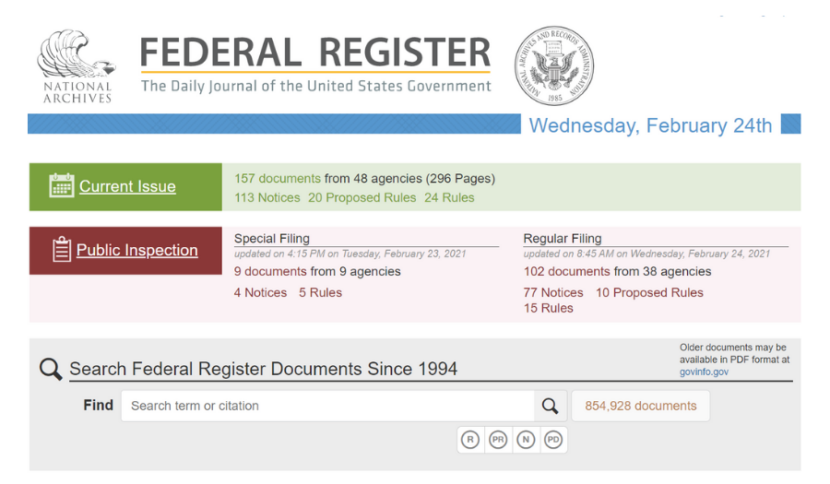
The Federal Register
Essential tool for tracking what agencies are planning and where to focus advocacy attention.
The official daily journal of the U.S. government. It’s published every business day
All proposed rules, final rules, notices, and presidential documents are published here
Available at federalregister.gov and advocates can set up email alerts for specific agencies (CMS, FDA, NIH)
The comment portal Regulations.gov links directly from Federal Register notices

Slide 18
CMS Rulemaking in Depth and How ASE Engages
Section Four

Slide 19
The Annual CMS Rulemaking Calendar
CMS operates on a predictable annual cycle. ASE must be engaged year-round, not just when a final rule drops.
February - March
April - May
July
President’s Budget Request
Sets funding priorities for all agencies including CMS and NIH
CMS begins drafting
Internal development of proposed rules; early stakeholder meetings most impactful here
Proposed Rules released
Physician Fee Schedule (PFS), HOPPS, and ASC proposed rules published. Includes proposed payment rates, coding changes, and quality updates
August - September
November
January 1
Public Comment Period
Typically 60-day window for ASE to submit detailed written comments on the PFS, HOPPS, and ASC proposed rules
Final Rules published
Final payment rates and policies announced for PFS, HOPPS, and ASC. ASE reviews for changes affecting echo services across all settings
New Rates Take Effect — finalized payment rates and policies go into effect
Finalized Medicare payment rates and policies go into effect for the new calendar year

Slide 20
The Physician Fee Schedule (PFS):
What It Is & Why ASE Cares
The PFS sets Medicare payment rates for every physician service including all echo procedures.
CF
(conversion factor: dollar value)
PAYMENT = [(WORK RVU × WORK GPCI) + (PE RVU × PE GPCI) + (MP RVU × MP GPCI)] × CF
Work RVU
(physician effort)
WORK GPCI
(geographic adjustment)
PE RVU
(practice
expense)
PE GPCI
(geographic adjustment)
MP RVU
(malpractice)
MP GPCI
(geographic adjustment)
Work RVU:
Reflects the physician's time, effort, skill, and stress. Changes to Work RVUs directly affect how echo services are valued relative to other procedures.
Practice Expense RVU:
Covers the costs of running a practice (equipment, staff, overhead). A major component for facility-based echo services.
Conversion Factor (CF):
A dollar multiplier applied to total RVUs. CMS adjusts the CF annually. Even small changes have large aggregate payment impacts across all echo services.
Budget Neutrality: Congress requires the PFS to be budget-neutral. Payment increases for some codes require offsetting cuts to others.

Slide 21
HOPPS & ASC: Additional Proposed Payment Rules
Beyond the PFS, CMS releases two other major proposed payment rules each July that affect where and how echo services are reimbursed. ASE reviews and comments on both.
July Proposed rules released
Aug – Sept Comment period
November Final rules published
Jan 1 New rates take effect
HOPPS (Hospital Outpatient PPS)
Medicare's payment system for hospital outpatient services, using Ambulatory Payment Classifications (APCs)
Echo procedures performed in hospital outpatient departments are paid under HOPPS rates, not the PFS
Changes to APC payment rates directly affect outpatient cardiovascular imaging
ASE's Engagement on HOPPS
ASE reviews the HOPPS proposed rule each summer and submits comments on provisions affecting cardiovascular imaging, echocardiography APCs, and hospital outpatient coverage policies impacting ASE members
ASC (Ambulatory Surgical Center) Payment
Sets payment rates for surgical procedures performed in ASC settings
Relevant when echo-guided procedures (e.g., TEE during structural heart interventions) are performed in ASCs
Published jointly with HOPPS each year due to shared APC-based methodology.
ASE's Engagement on ASC
ASE reviews and comments on the ASC proposed rule alongside HOPPS during the same comment window, focusing on ASC payment rates for echo-guided and cardiovascular procedures performed in outpatient surgical settings

Slide 22
Coverage Determinations: NCDs and LCDs
Coverage decisions determine whether Medicare will pay for a procedure at all, separate from the Fee Schedule.
National Coverage Determination (NCD) | Local Coverage Determination (LCD)
Issued by CMS centrally and applies to ALL Medicare beneficiaries nationwide | Issued by a Medicare Administrative Contractor (MAC) and applies only in their geographic region
Initiated by CMS or through a formal coverage request from a stakeholder | 15 MACs cover different regions; LCDs can vary significantly by region
Involves a formal evidence review process (often 18–24 months) | Faster to obtain than NCDs as MACs have more flexibility
Can cover, non-cover, or cover with conditions (e.g., only in clinical trials) | Often the first line of coverage policy for emerging echo technologies and indications
ASE can submit evidence to support or oppose an NCD, and request reconsideration | ASE can submit clinical evidence directly to the relevant MAC and request meetings

Slide 23
How to Engage in the Rulemaking Process
Section Five

Slide 24
Your Participation in the Rulemaking Process
Participation in federal rulemaking is a legal right and professional society comments carry significant weight.
Legal Right to Comment
The Administrative Procedure Act guarantees any person or organization the right to submit written comments on any proposed federal rule
Agencies Must Respond
Unlike Congress, federal agencies are legally required to read every substantive comment and address them in the final rule preamble
Your comments become part of the permanent regulatory record
Clinical Expertise Carries Weight
CMS and FDA are not full of echocardiographers
Comments grounded in clinical experience, patient outcomes, and peer-reviewed evidence often shift agency thinking in ways that general policy comments cannot
Comments are Public Record
All submitted comments appear in the public docket on Regulations.gov
They build the evidentiary foundation for the rule
Deadline is Firm
Late comments are not accepted
Missing the comment deadline means waiting an entire year for the next rulemaking cycle
ASE sets internal deadlines well ahead of the official deadline

Slide 25
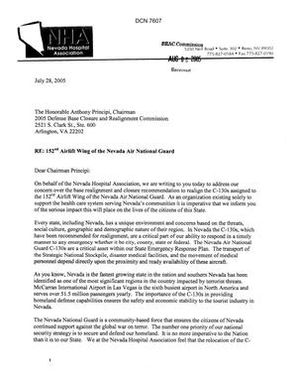
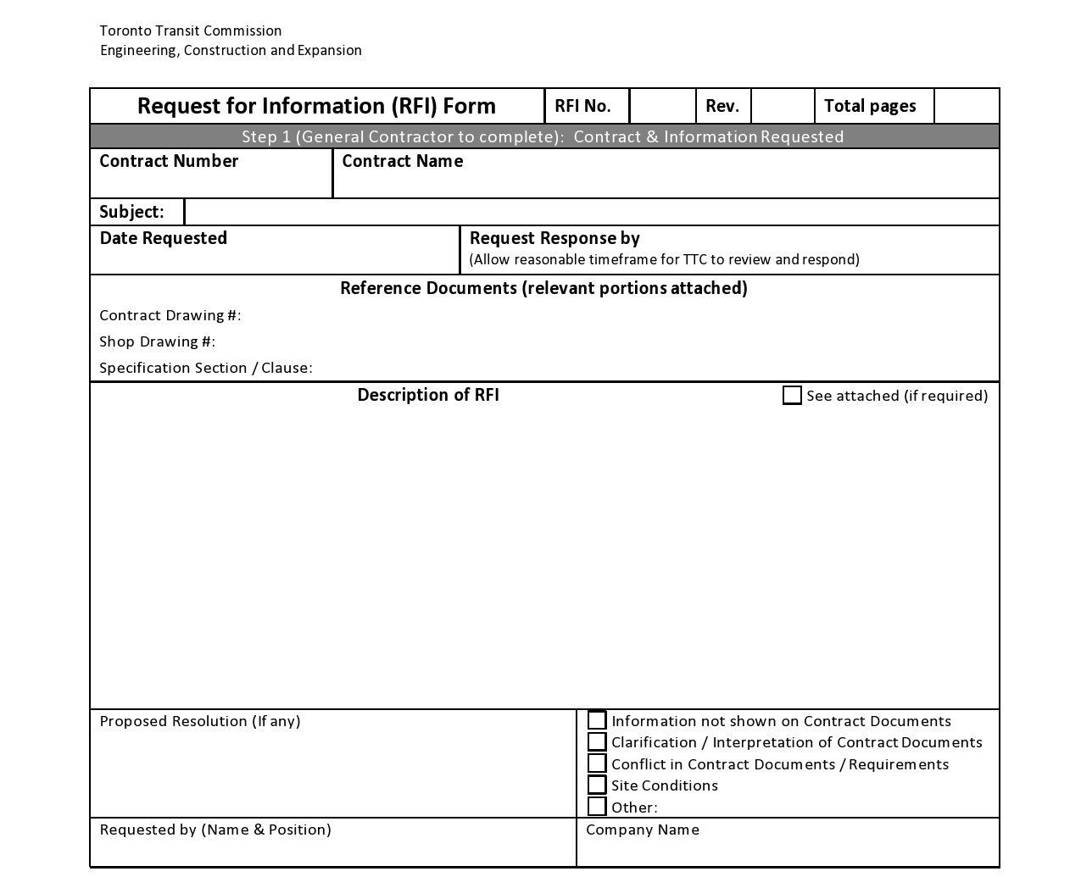


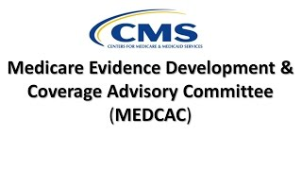
Beyond Public Comments: Other Engagement Opportunities
The comment period is the most visible window but it's not the only one. Earlier engagement often has more impact.
Pre-Rule Stakeholder Meetings
FDA Advisory Committees
MEDCAC
Request for Information (RFI)
Coalition Comment Letters
RUC (RVU Update Committee)
Meet with CMS or FDA staff before a rule is drafted; the highest-leverage opportunity, when agencies are most open to input
Public panels advising FDA on device approvals and policy; ASE members can serve on or testify before these committees
Advises CMS on whether evidence supports coverage for specific interventions; ASE can submit written testimony at public meetings
Agencies issue RFIs before formal rulemaking to gather stakeholder input; responding positions ASE as a key voice early
Multi-society letters amplify impact; CMS takes coordinated specialty society positions seriously
The AMA-convened process that recommends RVU values to CMS; ASE participates to advocate for appropriate valuation of echo procedures

Slide 26
Rulemaking vs. Legislation & Where You Fit In
Section Six

Slide 27
Rulemaking vs. Legislation: Knowing Which Tool to Use
The same health care policy goal can sometimes be achieved through either Congress or an agency.
Engage an Agency (Rulemaking) | Engage Congress (Legislation)
Change a Medicare payment rate or RVU value | Change the statutory formula for Medicare payments
Expand or limit coverage for an echo procedure (NCD/LCD) | Require CMS to cover a procedure the agency refuses to cover
Modify prior authorization requirements for imaging | Override a CMS or FDA rulemaking decision
Shape FDA clearance criteria for echo devices or AI tools | Fund a new program or research priority at NIH
Influence research funding priorities at NIH/NHLBI | Address a problem requiring new legal authority agencies don't have
Change quality measures in MIPS/APM programs | Set a permanent policy that can't be reversed by the next administration
Sometimes both are needed
Ex: if CMS refuses to act, Congress can write the policy directly into statute.

Slide 28
Where Your Voice Matters Most
Every stage of the regulatory process has an advocacy window. Know when and how to engage.
Pre-Rule Engagement
Before Prop. Rule
Request meetings with CMS or FDA staff; provide data and clinical framing before positions are set
Proposed Rule Released
Comment Period
Submit detailed, specific, evidence-based written comments. ASE's most consistent annual advocacy action
Advisory Committees
As scheduled
Serve on or testify before FDA advisory panels and MEDCAC. This puts clinical expertise directly before decision-makers
Final Rule Published
November (PFS)
Review for changes, prepare member communications, and assess need for congressional follow-up
Post-Rule Guidance
Year-round
Engage on sub-regulatory guidance, FAQs, and implementation guidance that interprets the final rule

Slide 29




Ready to Engage?
Every stage of the regulatory process has an advocacy window. Know when and how to engage.
Track the annual CMS PFS Proposed Rule released each July; comment deadline is September
Sign up for ASE advocacy alerts to be notified when your input is needed on a proposed rule
Consider serving on an FDA advisory committee or submitting testimony to MEDCAC
Engage ASE's advocacy team as your clinical experience strengthens ASE's comment letters
Visit ase.org/takeaction for comment letter templates, regulatory alerts, and current advocacy priorities

